Slide 1
Timeline
DATE | TOPICS | RELATED TOPIC
23/6/2025 – 27/6/2025 | Setting up the development environment (Visual Studio, CUDA Toolkit, OpenCV, and other dependencies). Run the xvtCudaBatteryExample Calculate the maximum outer of lower part of the battery

Slide 2
BATTERY INSPECTION PROJECT

Slide 3
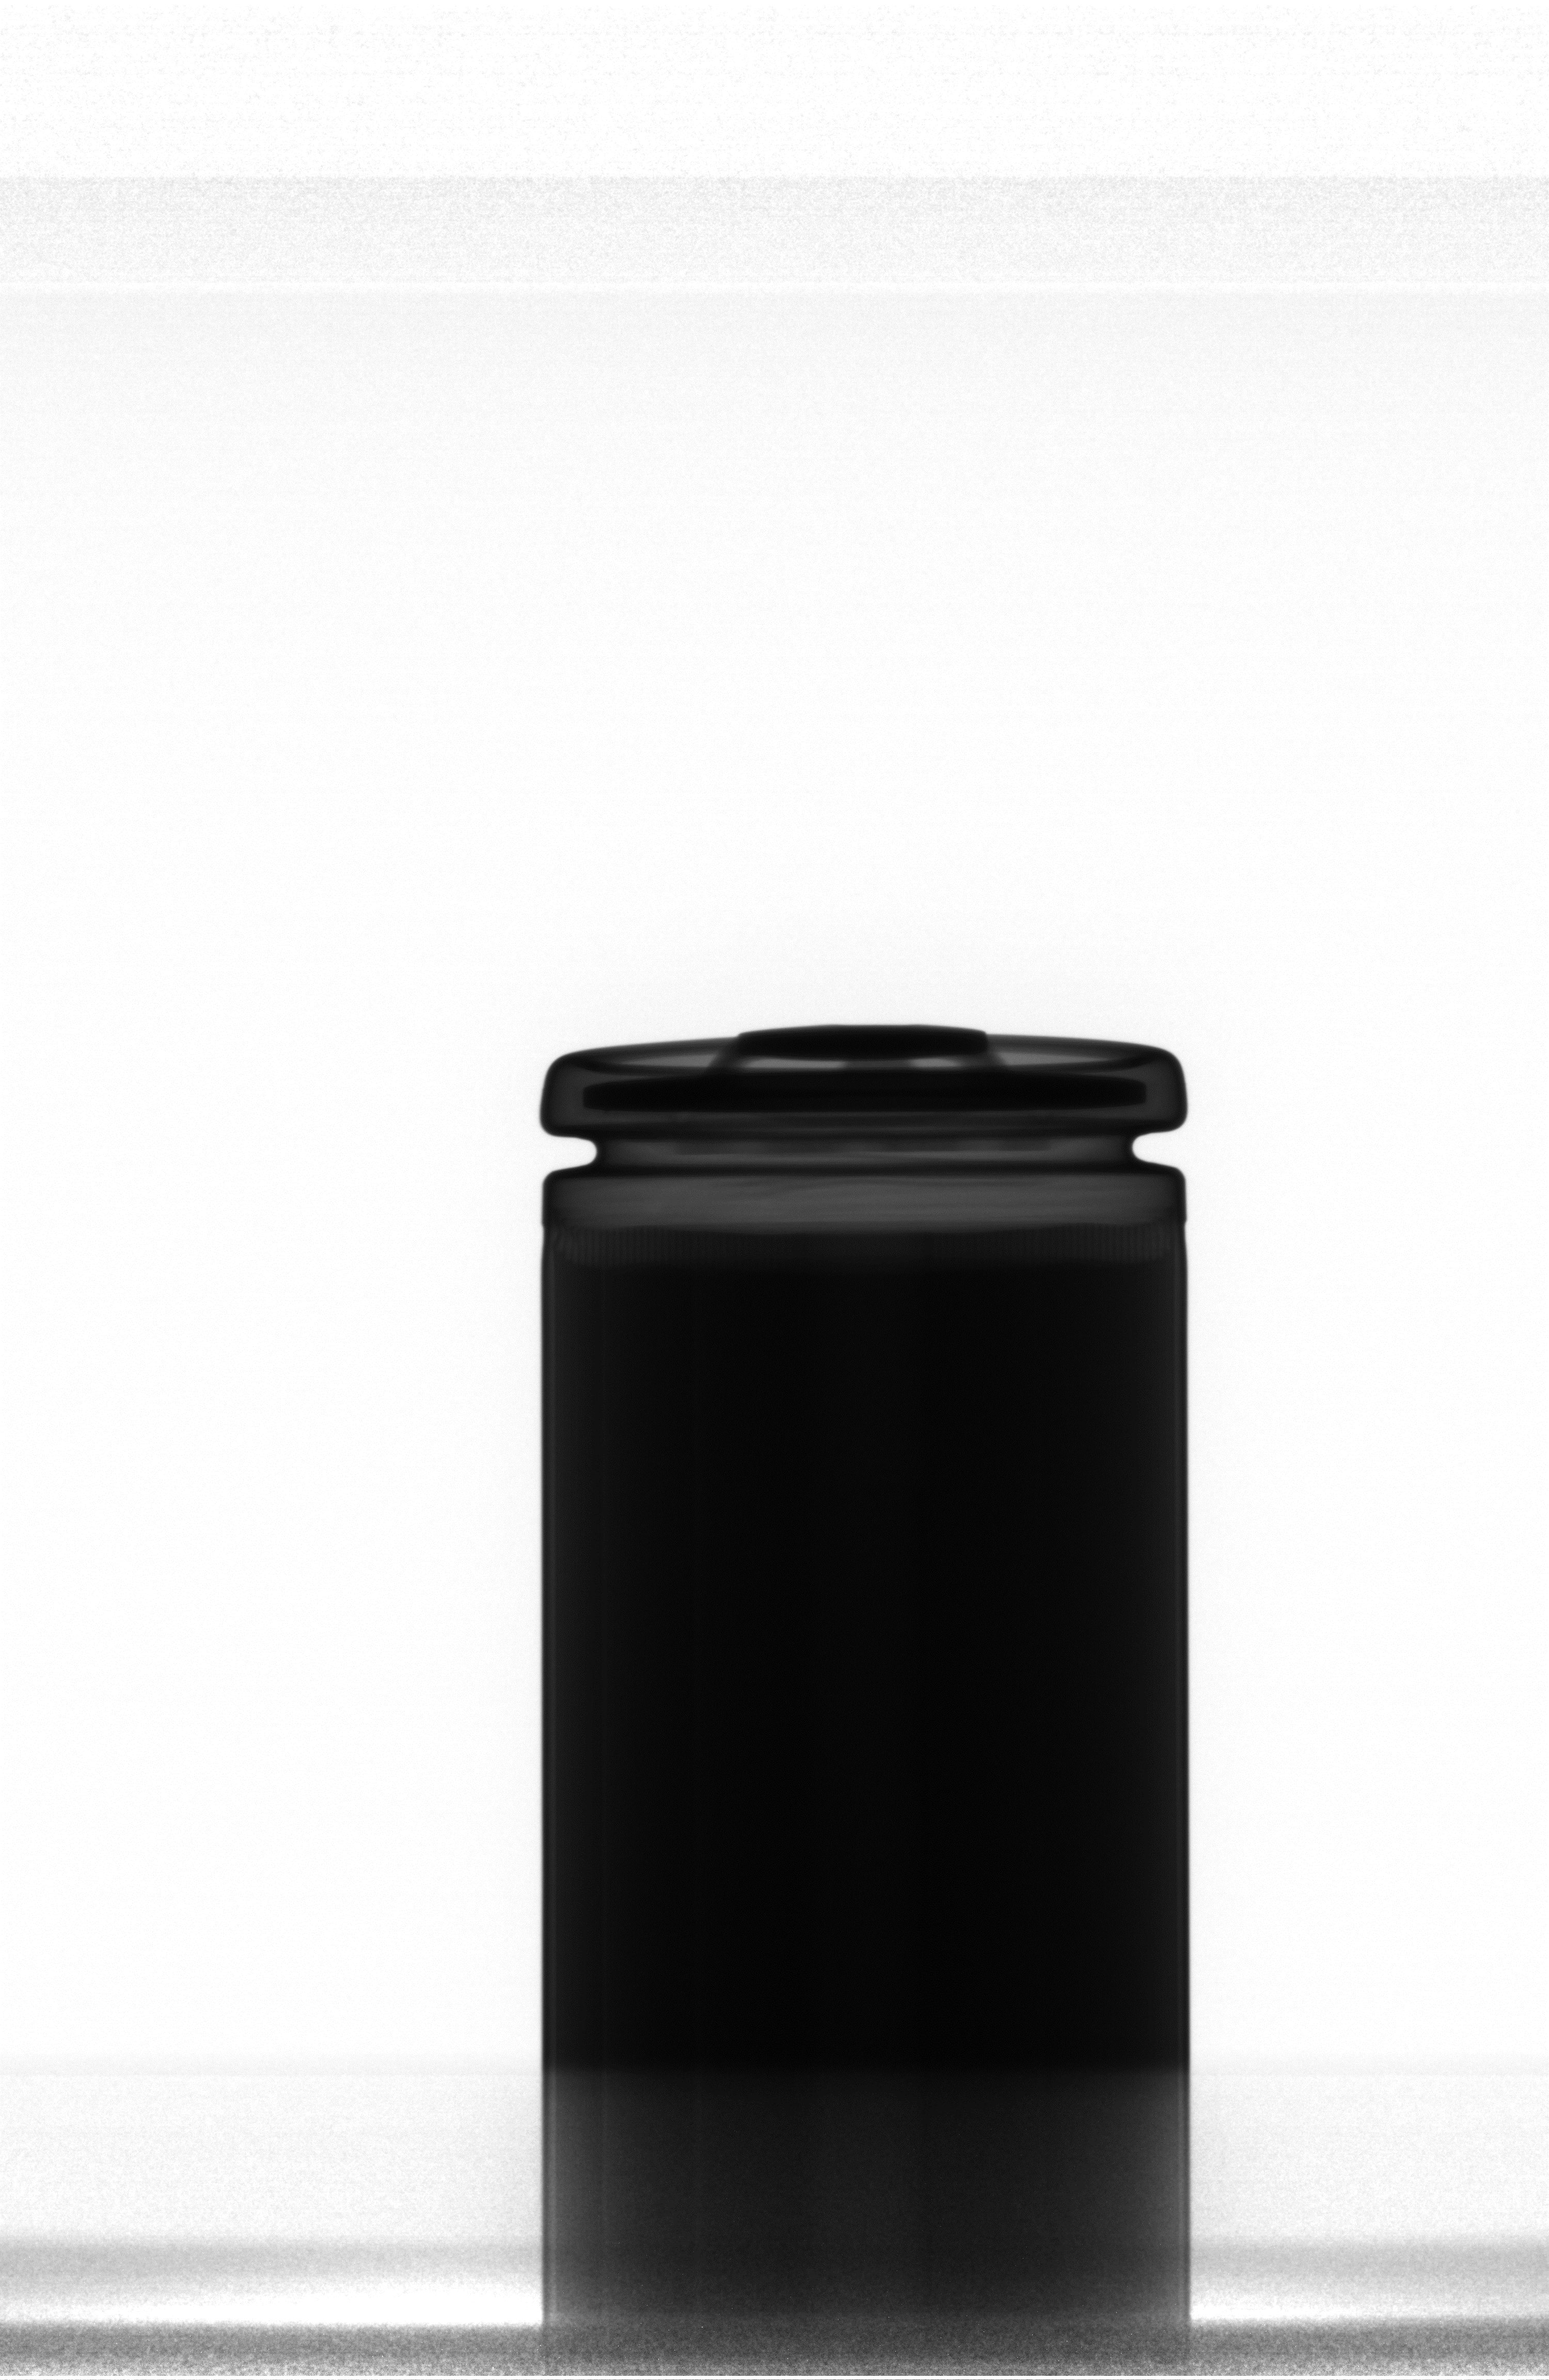
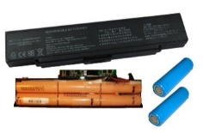
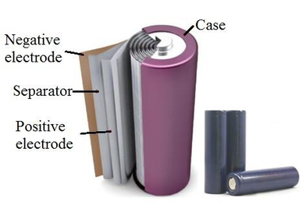
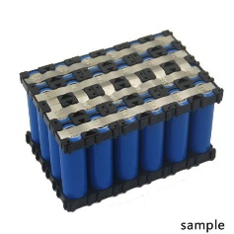
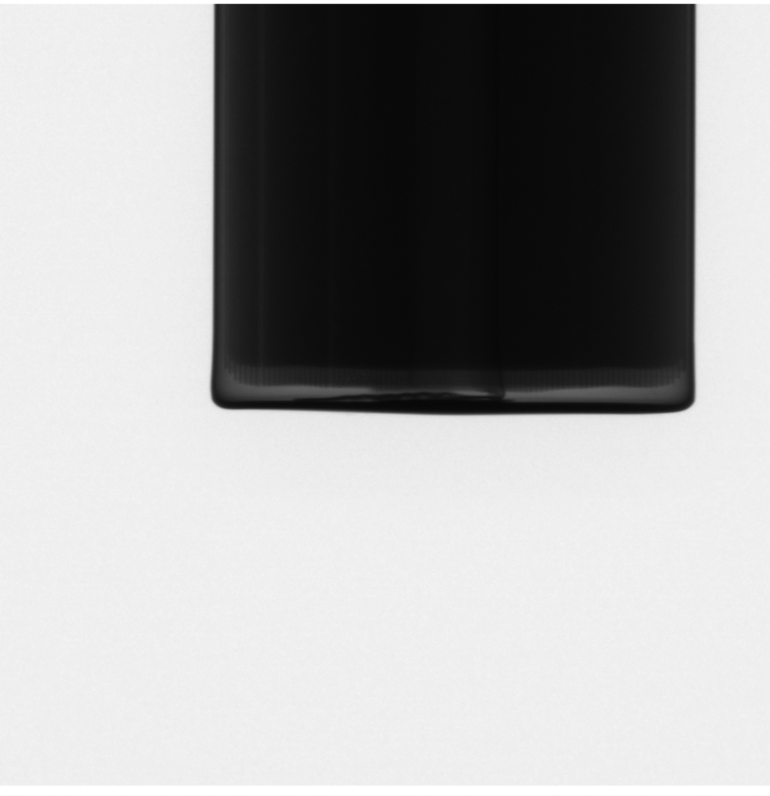
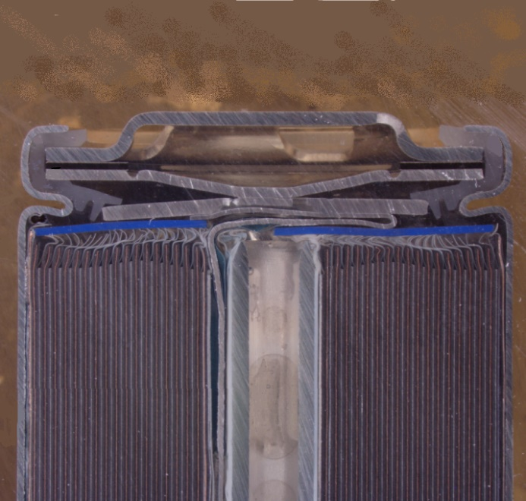
Battery inspection project
Cylinder battery
Xray-machine
Image Source: Murashko, Kirill. "Thermal modelling of commercial lithium-ion batteries." (2016).
Sample image (upper)
Separator (Jelly-Roll)
Negative pole
Positive pole
Sample image (lower)

Slide 4
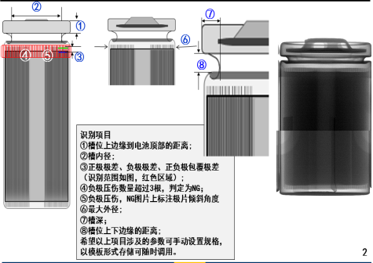
Goal of detection
Inspection Item:
① : Thickness of top cover
② : The inner diameter of the plant
③ : Distance between negative pole and positive pole.
④ : Number of NG negative pole (bent or tilted).
⑤ : Inclination angle of tilted poles.
⑥ : Maximum outer diameter
⑦ : The depth of the groove
⑧ : Distance between upper and lower edges.
Target:
Accurately measure internal linear distances between poles and Identify misaligned components
Challenge:
Input images have poor contrast
Shadow effect cause by Jelly Roll (separator)
Tab interference (in lower part)

Slide 5
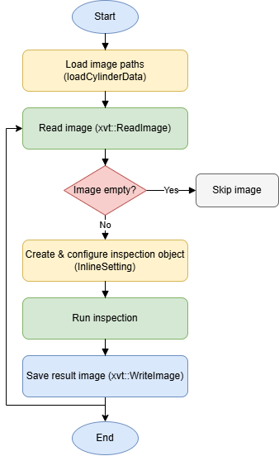
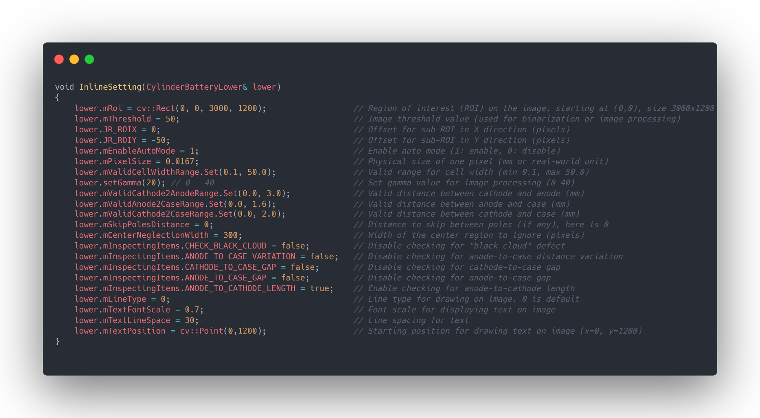
xvtBatteryExample to inspect Lower part

Slide 6
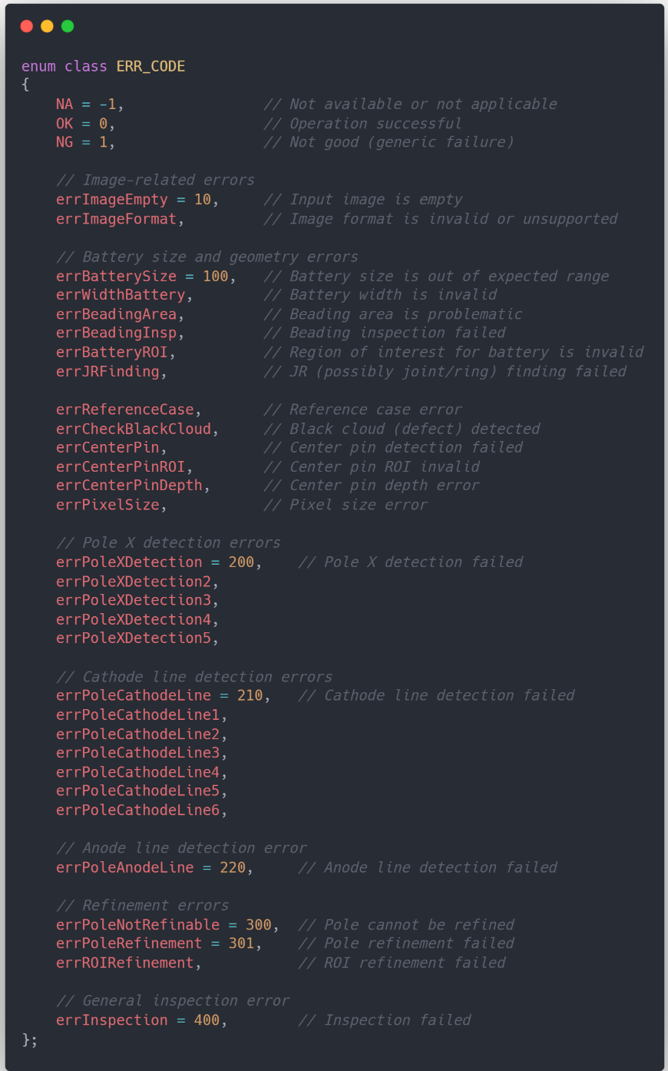
Error code

Slide 7
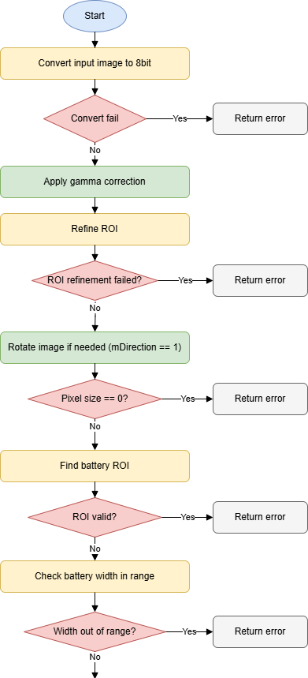
Inspection → Inspection2
Contrast enhancement
Preprocessing
Adjusts a selected ROI (Region of Interest) to ensure it remains inside an image.
Standardize the inspection process for both the lower and upper parts

Slide 8
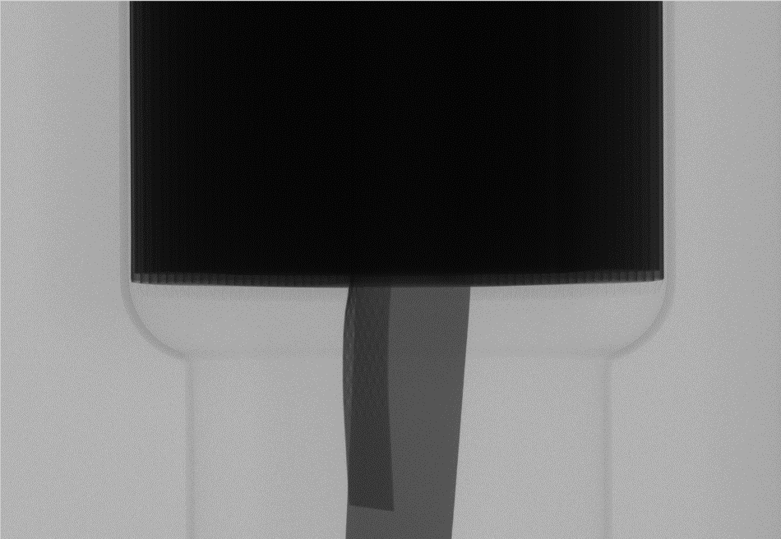
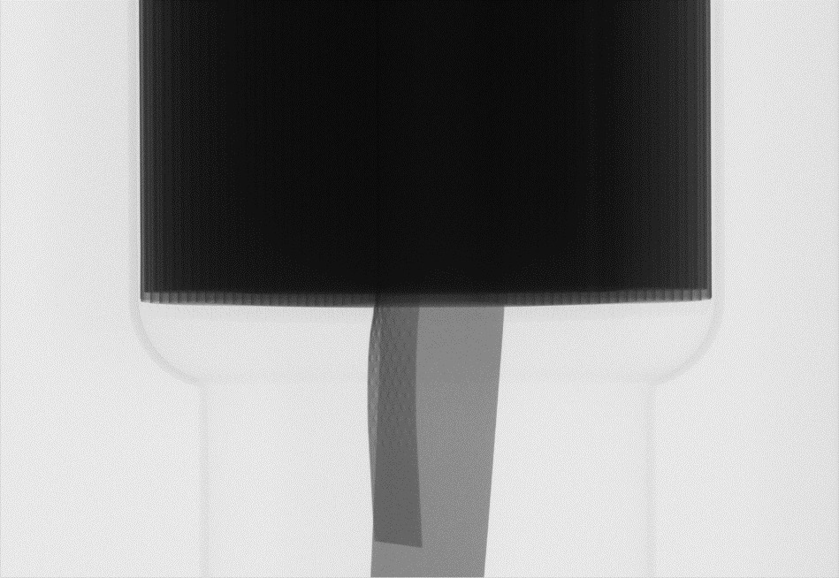
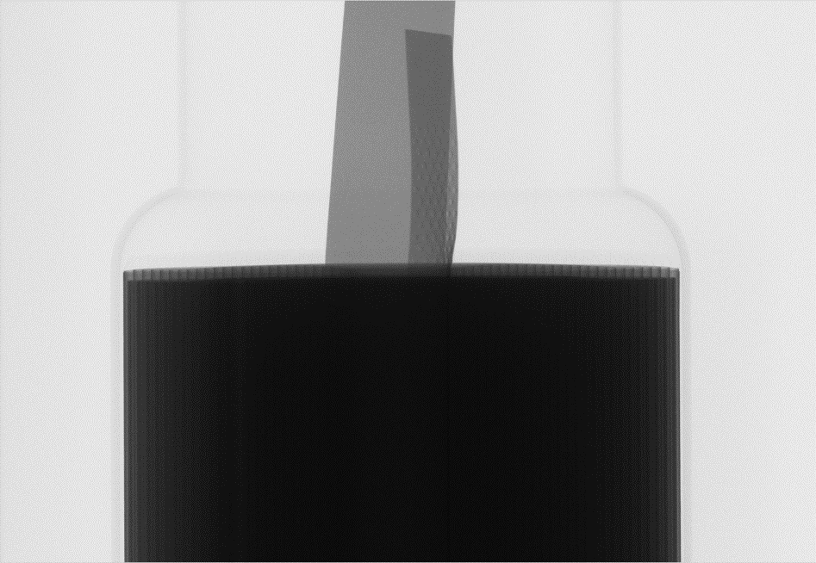
Inspection2
Apply gamma correction
Rotage image

Slide 9
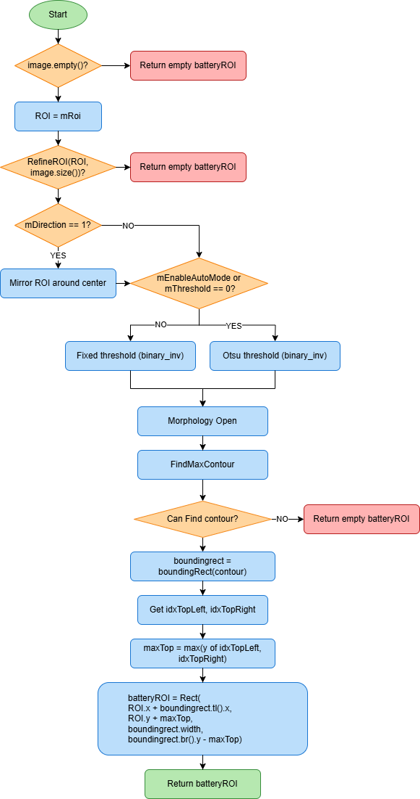
Find battery ROI

Slide 10

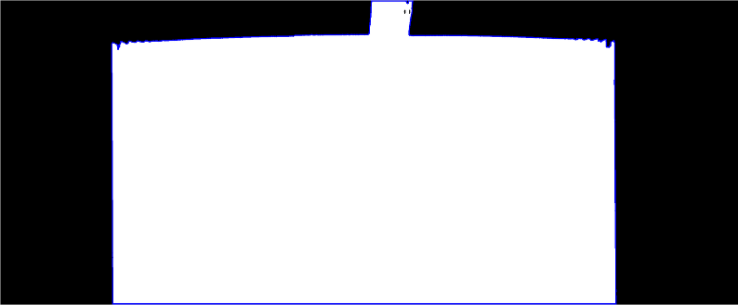

Find battery ROI
Image before rotation
ROI
Image after rotation
Mirror ROI around center
FindMaxContour
Threshold
Image(ROI)

Slide 11
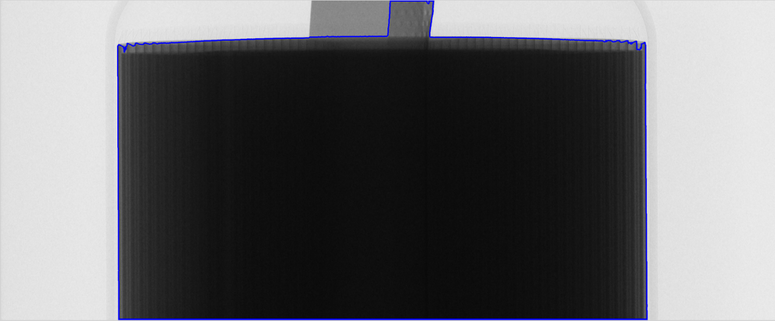
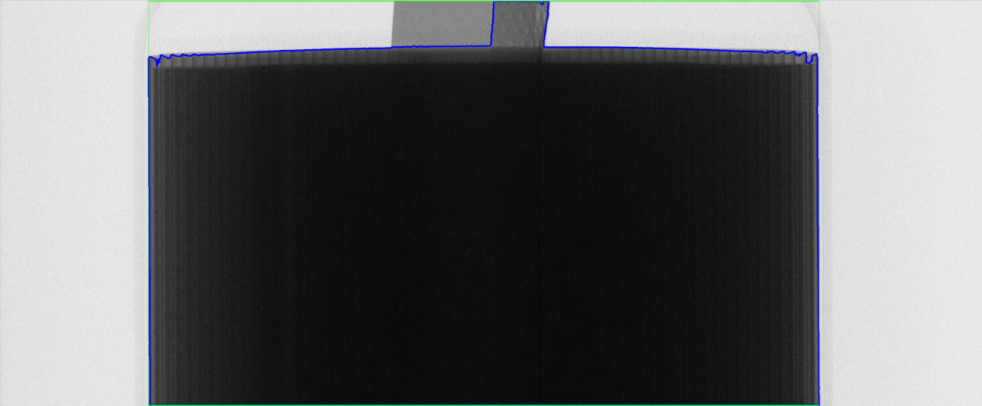

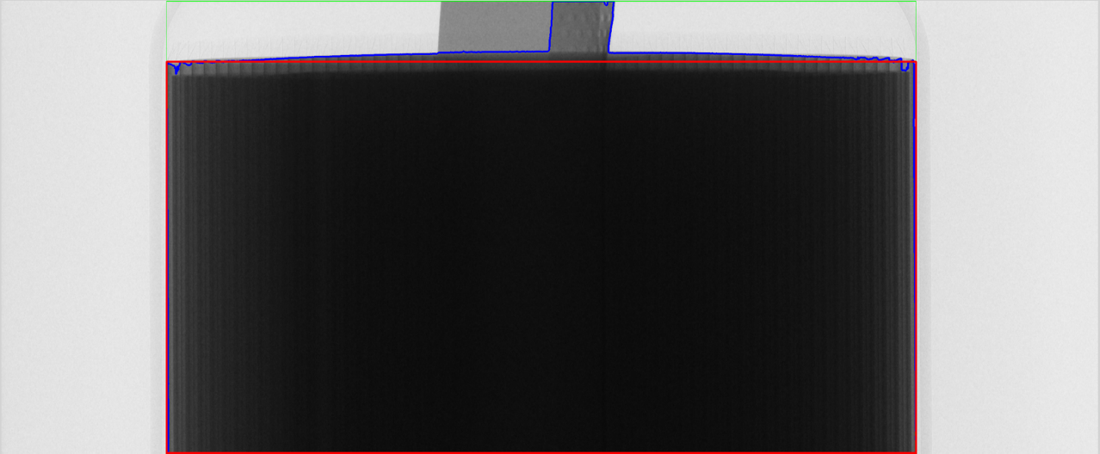
Find battery ROI
Top-Left
Top-Right
boundingRect(contour)
Battery ROI
Battery ROI
Top-Left
Top-Right

Slide 12
Find battery ROI
Image before rotation
ROI
Image after rotation
Mirror ROI around center
FindMaxContour
Threshold
Image(ROI)

Slide 13

batteryROI.y
roiBtmYPosition

Slide 14
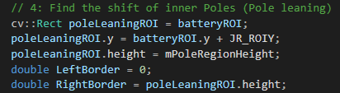
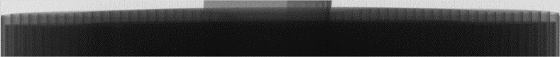
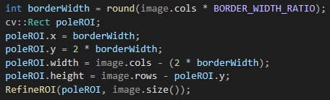
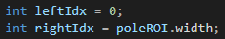
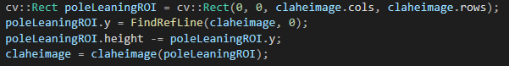
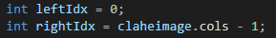

Slide 15
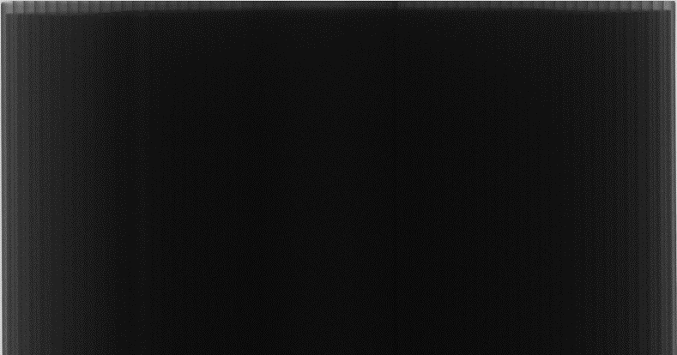


Slide 16
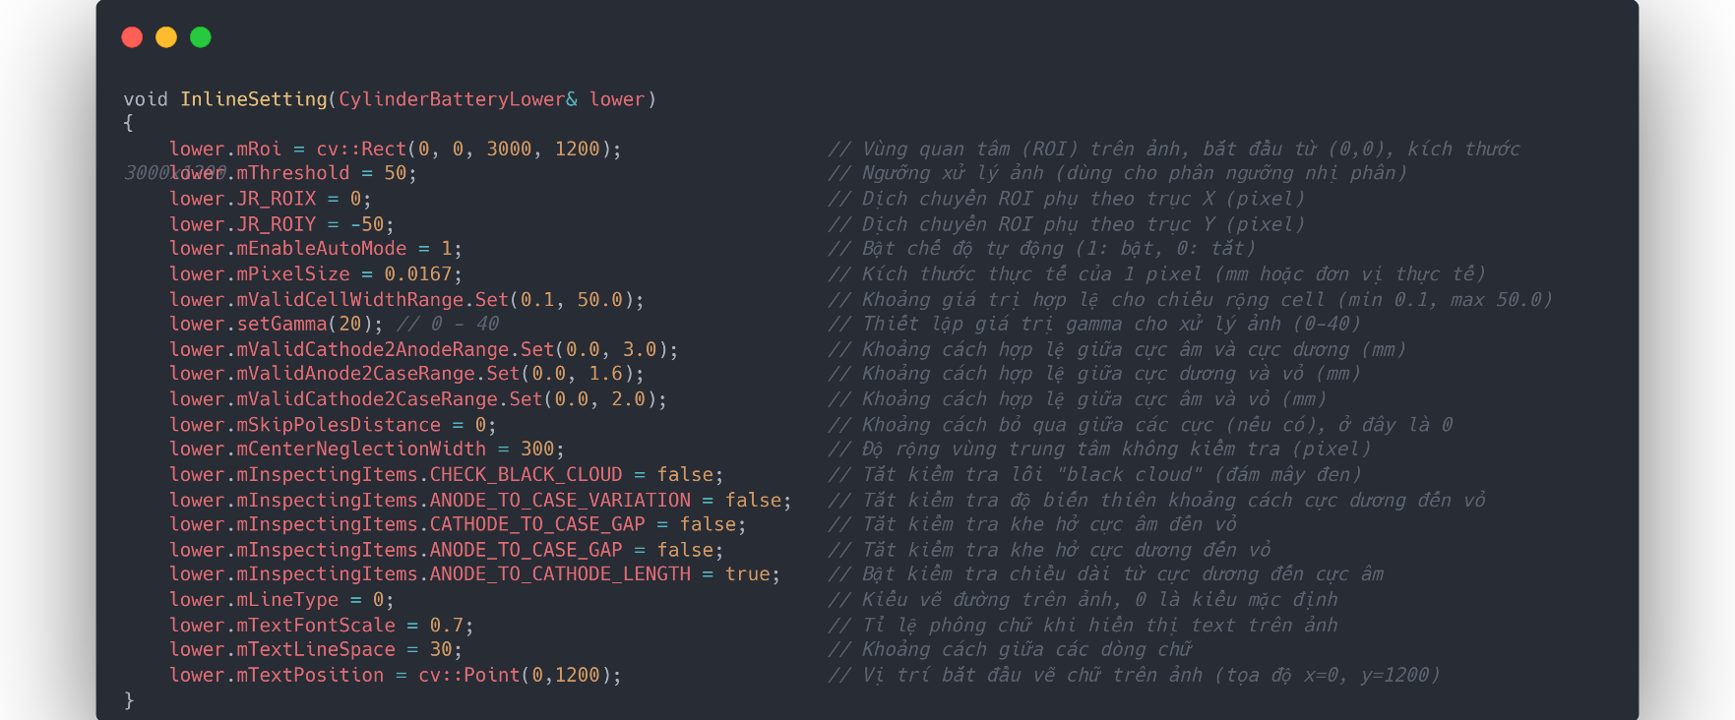

Slide 17
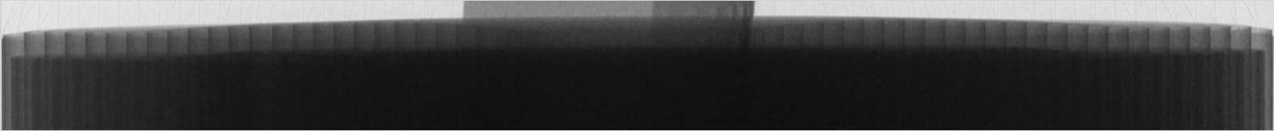

Slide 18
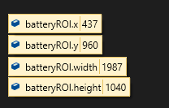
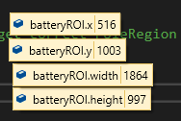

Slide 19
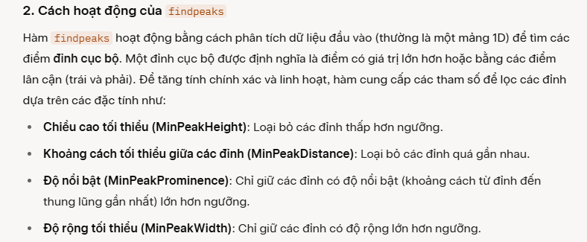

Slide 20
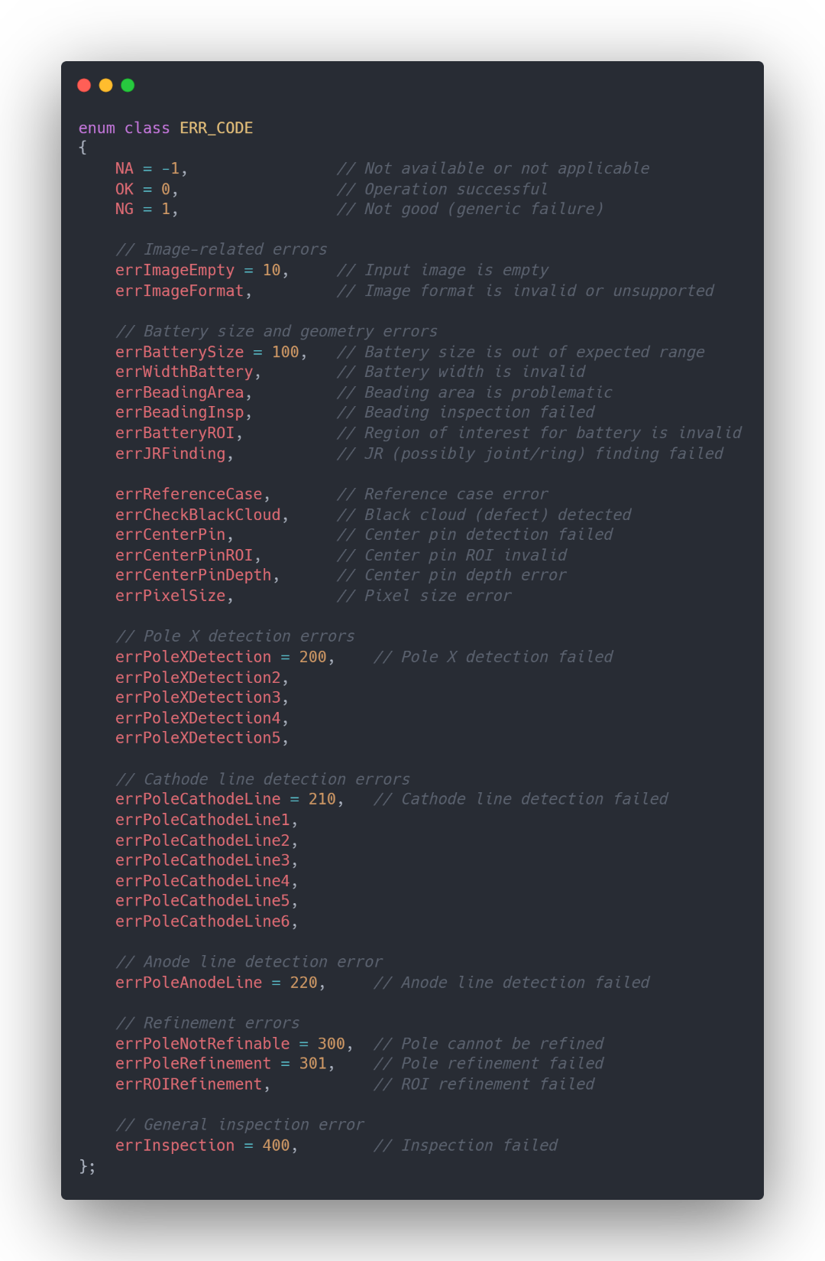
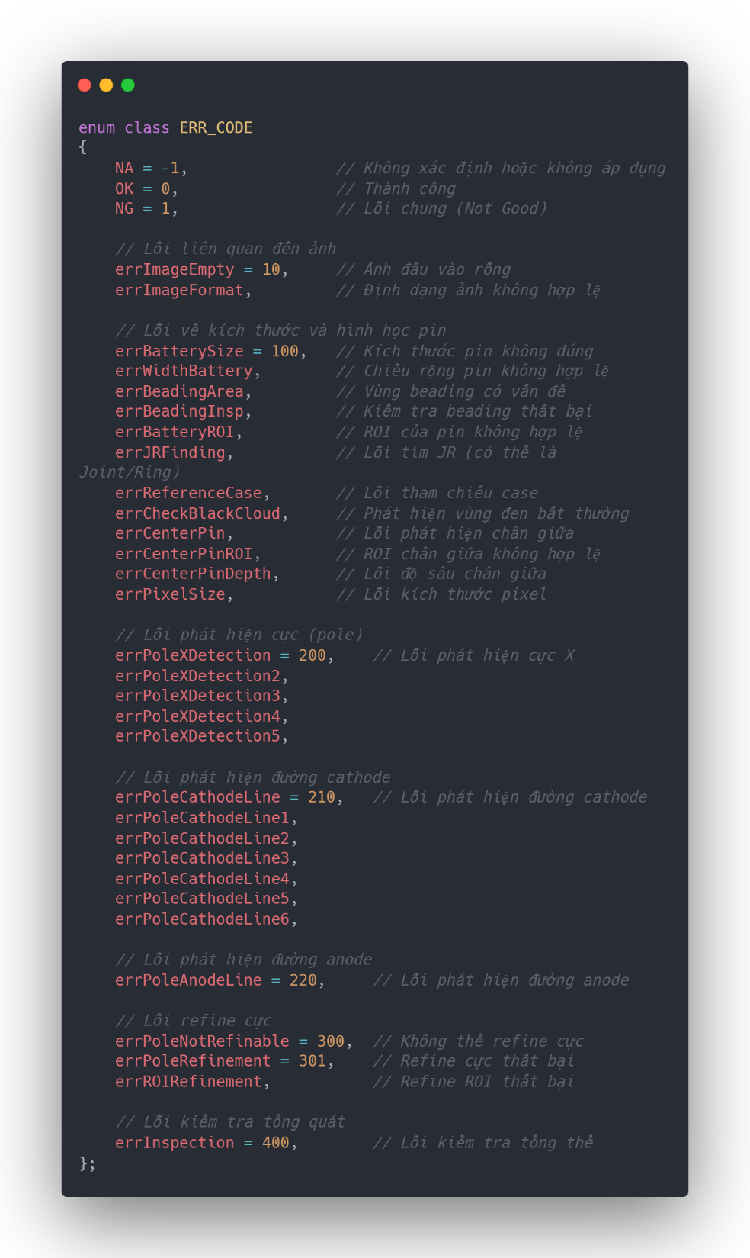

Slide 21

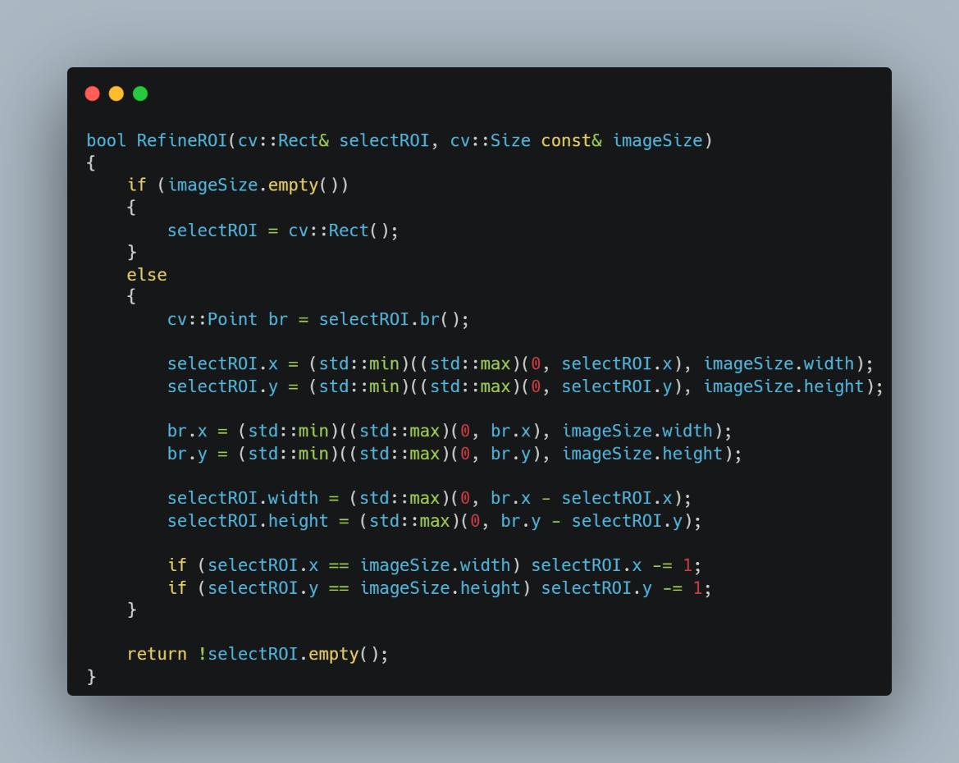
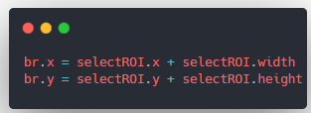
Nếu selectROI có tọa độ (x, y) và kích thước (width, height), thì: br (bottom right)

Slide 22
